Slide 1
Chapter 16 Metadata Mangement
Ilhyun Suh

Slide 2
Contents
Introduction
Metadata manager in SimpleDB
Table metadata
View metadata
Statistical metadata
Index metadata

Slide 3
Contents
Introduction
Metadata manager in SimpleDB
Table metadata
View metadata
Statistical metadata
Index metadata

Slide 4
Introduction
A record file is just useless by itself (without knowing how it is organized)
A table (or an index) needs some additional data aside from the records in order to be decoded
Table’s name
Table’s schema
Index’s name
List of its indexed fields
The query planner calculates the estimated cost for processing and use them to improve execution time
Table’s statistical information

Slide 5
Metadata
Metadata
Information about the database, apart from its contents
Representative metadata
Table metadata
Table information (Table management)
Structure of the record (read/write records)
View metadata
Properties of each view (helping processing queries that use views)
Index metadata
Information of the index (deciding the usage of indexes)
Statistical metadata
Size of table, distribution (estimating cost of query)

Slide 6
Contents
Introduction
Metadata manager in SimpleDB
Table metadata
View metadata
Statistical metadata
Index metadata

Slide 7
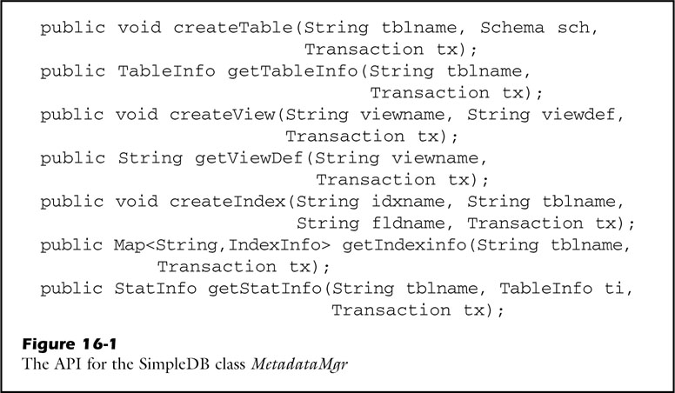
Metadata Manager
Metadata Manager
A portion of the DBMS that stores/retrieves its metadata
In SimpleDB
SimpleDB.mdMgr();
MetadataMgr
Table metadata (TableMgr)
View metadata (ViewMgr)
Index metadata (StatMgr)
Statiscal metadata (IndexMgr)

Slide 8
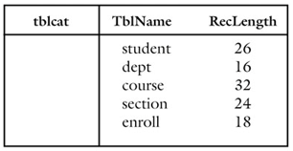
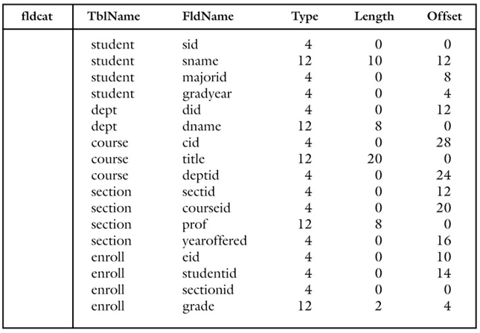
Table Metadata (TableMgr)
Manages table’s name and schemas
Such data are store in a repository called catalog
tblcat (TblName, RecLength)
fldcat (TblName, FldName, Type, Length, Offset)
INTEGER
VARCHAR

Slide 9
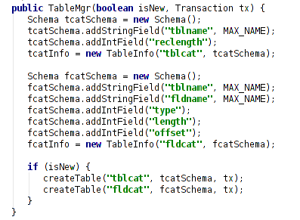
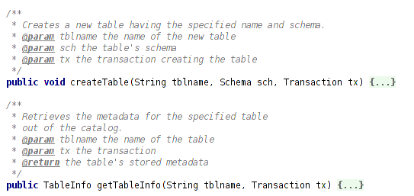
Table Metadata (TableMgr)
Constructor
and methods

Slide 10
View Metadata (ViewMgr)
Manages view definitions
View is a table whose records are computed dynamically from a query (definition)
View definitions are stored in a catalog table, viewcat
Viewcat (ViewName, ViewDef)

Slide 11
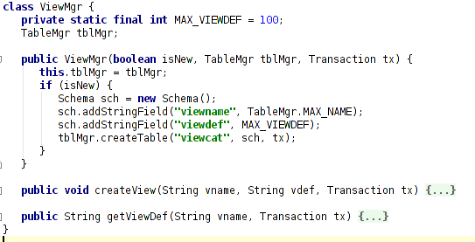
View Metadata (ViewMgr)
Constructor
and methods

Slide 12
Statistical Metadata (StatMgr)
Manages each table’s statistical information
How many records the table has
The distribution of the table’s field values
and a lot more in real world commercial database systems
Statistical information is important for query planner to estimate costs!
In SimpleDB, only three kinds are considered
Number of blocks used by each table T => B(T)
The number of records in each table T => R(T)
The number of distinct values of each field F in each table T (est)
=> V(T,F)

Slide 13
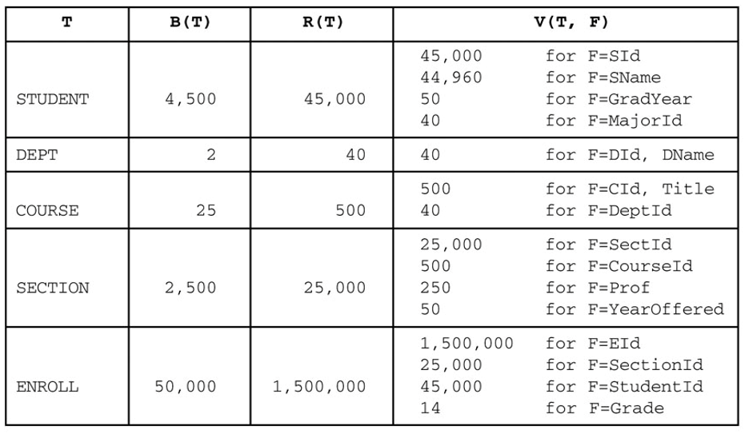
Statistical Metadata (StatMgr)
An example ( A student database of a university kept for 50 years)
900 new students per year
500 offered sections per year

Slide 14
Statistical Metadata (StatMgr)
Two ways to manage statistical data
Store the information in the database catalog
Will need tables such as
tblstats (TblName, Numblocks, NumRecords)
fldstats (TblName, FldName, NumValues)
Store the information in memory
Calculate and store the statistics directly in memory
Needs to be calculated from the scratch as the server database starts

Slide 15
Statistical Metadata (StatMgr)
Update strategies
Update the statistics when an update ocurrs in the table everytime
Increase of update costs
Additional operations to keep the statistics up-to-date
Writing the modified pages, writing the corresponding log records
Concurrency problems
Forget about the updates, recalculate them from the scratch sometimes
Accurate information may not be necessary

Slide 16
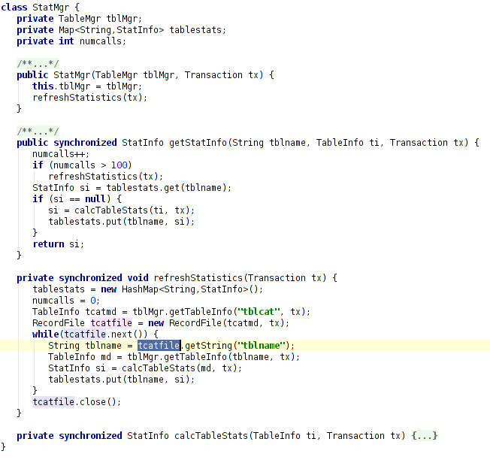
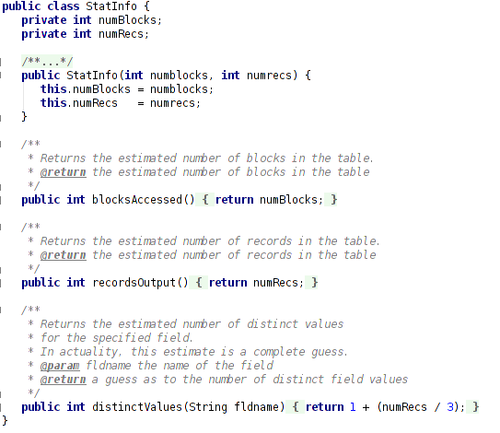
Statistical Metadata (StatMgr)

Slide 17
Index Metadata (IndexMgr)
Manages information about indexed
Index name
Name of the table it is indexing
Indexed fields
Index metadata are stored in a catalog table, idxcat
Idxcat (IndexName, TableName, FieldName)

Slide 18
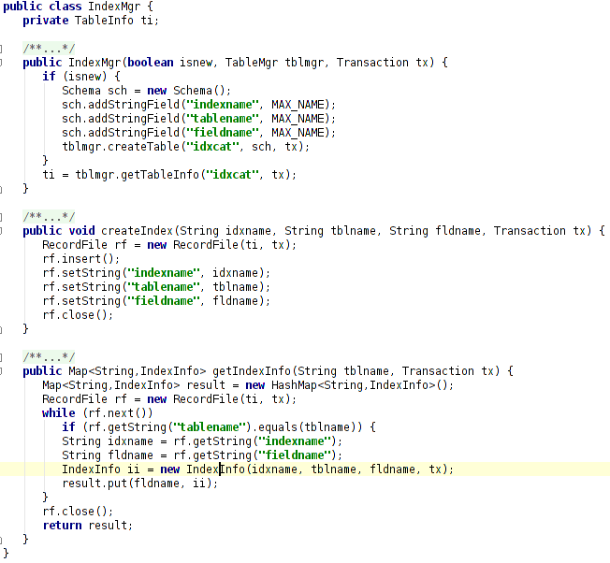
Index Metadata (IndexMgr)
Constructor
and methods

Slide 19
Index Metadata (IndexMgr)
Class IndexMgr provides further information about indexes
Class IndexInfo
blockAccessed
Estimated number of block accesses required to find all index records having a particular search key
recordsOutput
Estimated number of records having a search key
distinctValues
Distinct values for a specified field in the underlying table

Slide 20
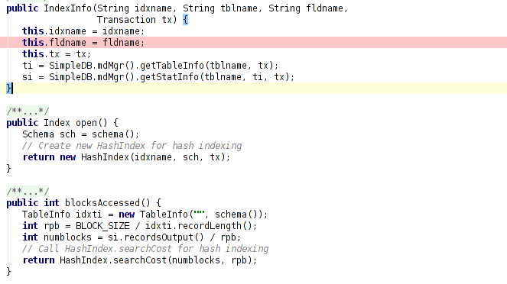
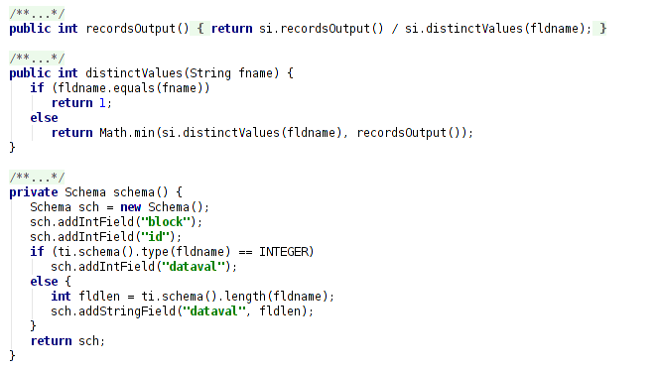
Index Metadata (IndexMgr)

Slide 21
Metadata Manager (Overall)
Metadata
(MetadataMgr)
[SimpleDB.mdMgr()]
Table Metadata
(TableMgr)
tblcat
fldcat
createTable
View Metadata
(ViewMgr)
getTableInfo
viewcat
createView
getViewDef
Stat Info
Statistical Metadata
(StatsMgr)
getStatInfo
createIndex
getIndexInfo
Index Metadata
(IndexMgr)
idxcat

Slide 22
QnA
Thank you!

